Slide 1




VerseVault – A Modern Poetry Sharing Platform
Presentation by :
Sachi Prajapati
Notes:
1

Slide 2




Agenda
Project Overview
Key Features
Understanding VerseVault's core purpose and scope.
Exploring the main functionalities offered to users.
Technical Architecture
Development Process & Outcomes
Diving into the full-stack technologies employed.
Highlighting project objectives and lessons learned.
Notes:
2

Slide 3
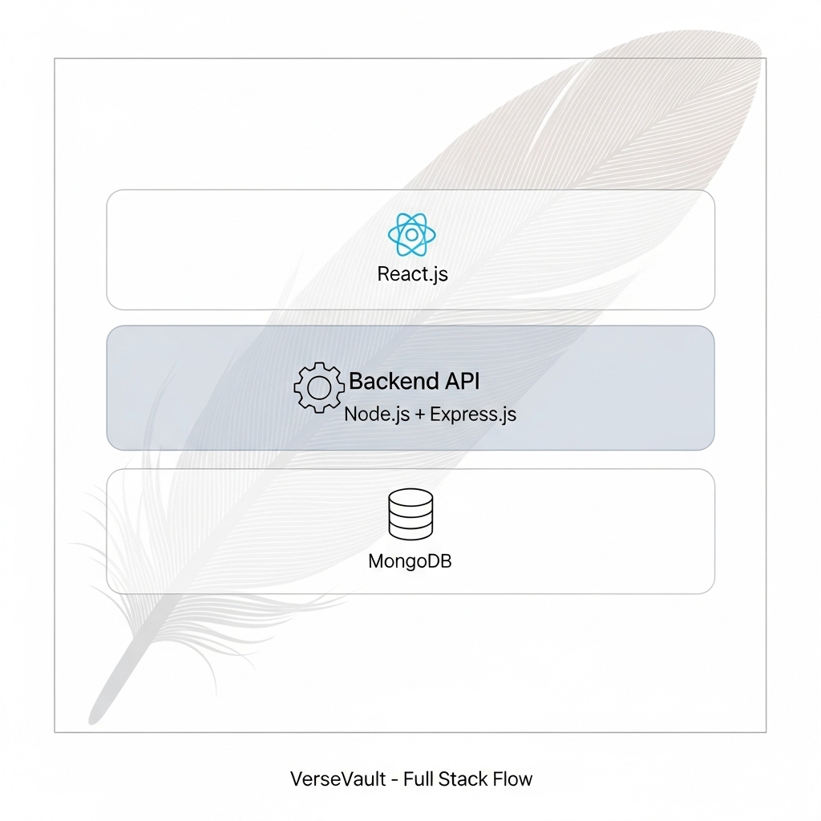
Project Overview
VerseVault is a full-stack poetry platform designed and developed during an intensive internship, aimed at simulating a real-world web application with a clean separation of frontend and backend responsibilities. The core purpose of the project is to provide a creative space where users can submit, browse, and share poems, while enabling administrators to moderate content through an approval system.
The application supports:
User authentication and role-based access, allowing distinction between regular users and admin.
Poem submission with metadata like author, category, and tags.
Admin dashboard to approve or reject poems, ensuring content quality.
Public poems page displaying only approved entries.
A responsive UI built in React, connected seamlessly with a Node.js + Express backend and MongoDB database.
Notes:
3

Slide 4




Core User Features
User Authentication
Poem Submission
Seamless login/logout functionality, currently using localStorage, with a scalable design ready for full authentication integration.
Intuitive forms allow users to submit poems complete with titles, authors, categories, tags, and rich content formatting.
Poem Browsing
User Dashboard
Readers can effortlessly discover new poetry through organized categories and relevant tags, enhancing content discoverability.
Personalized dashboards provide logged-in users with a dedicated space to manage their profile and view all their submitted works.
Notes:
4

Slide 5

Responsive Design for All Devices
VerseVault prioritizes a seamless user experience across all devices. Its design is fully responsive, adapting gracefully from mobile phones to tablets and large desktop displays.
This ensures accessibility and a consistent, high-quality interaction for every user, regardless of their preferred device.
VerseVault is built with a mobile-first, responsive layout using flexbox and media queries.
It adapts seamlessly across desktops, tablets, and smartphones.
Navigation (navbar, dropdowns, menus) and content (poems, cards, forms) are fully optimized for various screen sizes.
Ensures consistent user experience regardless of device or resolution.
Developed and tested using Chrome DevTools to simulate real-world devices.
Notes:
5

Slide 6






Full-Stack Technical Architecture
Frontend: React.js
Backend: Node.js & Express.js
Database: MongoDB
Developed with React.js, React Router, and custom CSS using styled components for a dynamic and responsive user interface.
Robust server-side logic powered by Node.js and the Express.js framework, handling API requests and business logic.
NoSQL database solution with MongoDB, managed efficiently using Mongoose ODM for flexible data modeling and persistence.
Notes:
6

Slide 7
Project Objectives & Outcomes
Objectives:
To build a full-stack web application enabling users to submit, view, and manage poems.
Implement user authentication for secure login and personalized features like "My Poems".
Design an intuitive admin interface to approve or reject submitted poems.
Ensure responsive UI for accessibility on all devices.
Store and manage poem data using MongoDB via a robust Express + Node.js backend.
Outcomes:
Successfully developed a working poetry platform with user registration, login, poem submission, and moderation system.
Achieved seamless frontend-backend integration using React and REST APIs.
Enabled dynamic content display, admin-only access, and real-time updates after actions like approval.
Delivered a clean, responsive UI tested across screen sizes.
Gained practical experience in real-world development workflows, including error handling, local storage use, and role-based access control.
Notes:
7

Slide 8
Key Takeaways & Next Steps
Key Takeaways:
Gained hands-on experience in building a full-stack application using React, Node.js, Express, and MongoDB.
Understood the importance of user authentication, role-based access, and data validation in real-world apps.
Learned how to design and implement a responsive and user-friendly UI.
Developed features like poem submission, admin approval, and content filtering, reflecting real product use-cases.
Strengthened debugging, API integration, and state management skills using local storage and React hooks.
Next Steps:
Add like and comment features with real-time updates.
Implement user profile pictures and enhanced security (e.g., password encryption, JWT).
Expand to include categories, bookmarks, and search functionality.
Explore deployment options to make the platform live and accessible to users.
Notes:
8

Slide 9
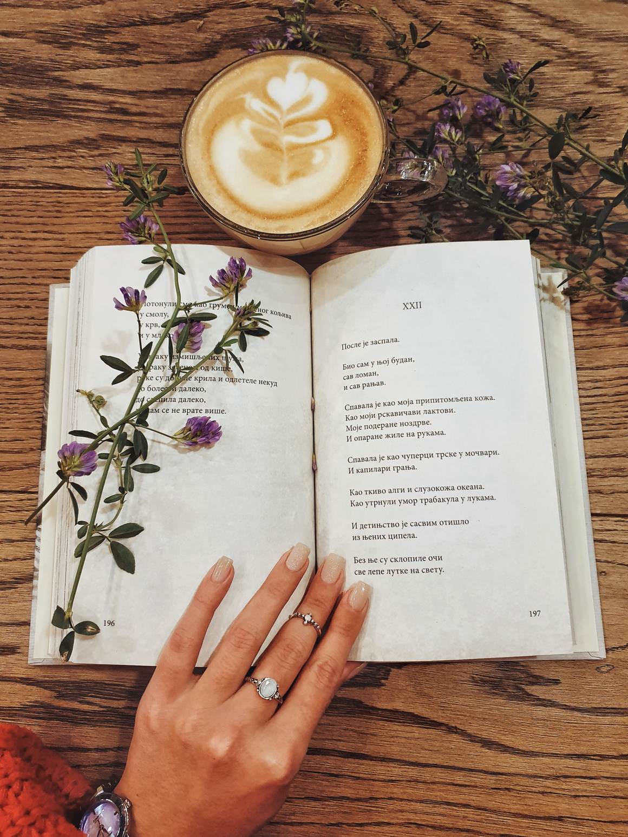
Conclusion
VerseVault isn't just a platform — it's a movement.
A digital sanctuary for poets and readers where every
voice matters and every verse finds a home.
What We've Built
A responsive and modern platform that bridges poets and readers, making poetry accessible, shareable, and celebrated.
Our Impact Vision
To inspire self-expression, nurture storytelling, and create a global space where art thrives through words.
Thank You !!
Feel free to explore, contribute, and grow with us on this poetic journey.

